Slide 1
Microsoft Robotics Developer Studio 2008
Rudi Grobler
Barone, Budge & Dominick
ASTRA Technology Core
http://dotnet.org.za/rudi

Slide 2
Microsoft Robotics Developer Studio 2008
Reusable components: Introduces a paradigm that facilitates reuse
Standardization: Introduces a hardware abstraction paradigm
Concurrency and distributed computing: Introduces CCR and DSS to greatly simplify these tasks
Simulation: Introduces a high-fidelity, extensible virtual world
Barrier to Entry: Introduces a Visual Programming Language to make the advanced features more accessible to newcomers.

Slide 3
VPL + Simulator

Slide 4

Microsoft Robotics Developer Studio 2008
Runtime
Authoring Tools
Services
CCR - Coordination and Concurrency library
DSS - Distributed Services Framework
Visual Simulation Runtime and Editor
Visual Programming Language
Samples and tutorials
Robot services
Robot models
Technology services

Slide 5
What is Concurrency?
“Concurrency is a property of systems in which several computations are executing simultaneously, and potentially interacting with each other.”
“The design of concurrent systems often entails finding reliable techniques for coordinating their execution, data exchange, memory allocation, and execution scheduling to minimize response time and maximise throughput”
Wikipedia

Slide 6
Why CCR?
Concurrency
Process many tasks (load-balance across cores)
Scalability, Responsiveness
Exploit latency
Coordination
Exercise control without blocking threads
Orchestrate asynchronous operations
New mechanism to handle failure for concurrent, asynchronous code
Runtime
Advanced scheduler with fairness, throttling
Extensible primitives

Slide 7
CCR Programming Model
Asynchronous in-process message passing
No explicit threads, locks, semaphores!
Task scheduled based on message availability
Data-dependency scheduler
Models concurrency
Coordination primitives (join, choice, …)
Composition of data-driven components
Iterative tasks
Express sequential control flow of asynch. tasks

Slide 8
Dispatcher schedules items from its queues round-robin to run in its threads
Post places a message on the port
Port
Enqueue work item
Dispatcher
Scheduler picks next work item to execute
Arbiter is activated on queue
Thread calls handler with message as arg
Creates work item from
message and handler
Arbiter checks whether it can consume the message
Arbiter
Dispatcher Queues
Threads
Handler
Arbiter is attached to port

Slide 9
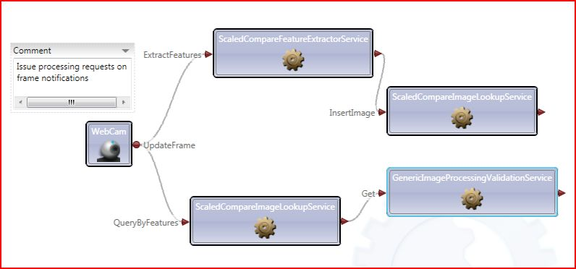
Why DSS?
Robust
Deep isolation (data and execution)
Contain and manage failure
Composable
Protocol and runtime support to create, manage, deploy, data driven applications
Runtime and tool support for service bindings
Publication/subscription integrated with structured state manipulation
Observable
Service is a living document addressable through URIs
Consistent mechanism for configuring, managing and controlling access

Slide 10



Concurrency & Coordination
State-Driven Composable
Flexible Development
Used by MySpace, Tyco & Siemens

Slide 11

Programming MRDS
Writing managed code
Any managed code language
C# provides Iterator mechanism for concise code
Visual Programming
Visual Programming Language
DSS Manifest Editor

Slide 12
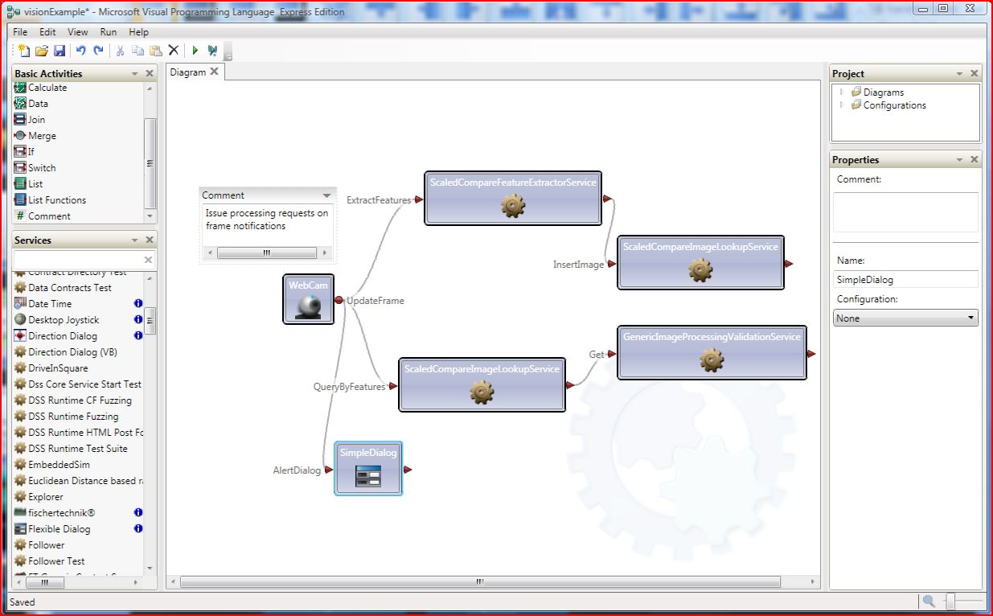
Visual Programming Language Orchestrating DSS services with dataflow
Use any DSS service
Connect services
Notifications
Request/Response
Control and logic
Data transformation
Control dataflow
Notification
Available DSS services
Service instance
Request
Response

Slide 13
Lego Mindstorm NXT 2.0

Slide 14

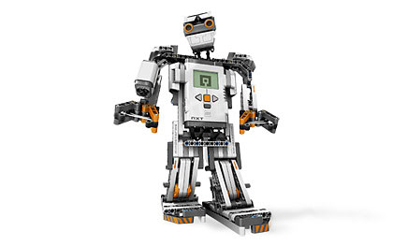
Mindstorm NXT 2.0
Estimated Price +/- $280
32-Bit processor
4 Input Sensors (Ultrasonic, Sound, Touch & Color Sensors)
3 Interactive servo motors

Slide 15
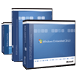
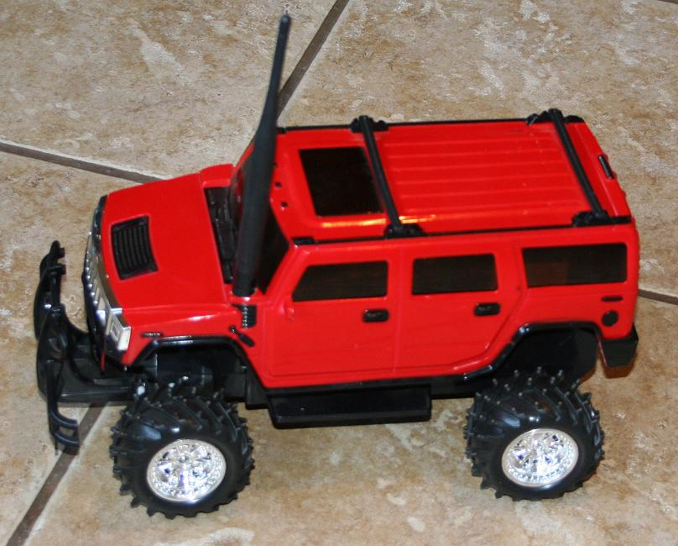
Windows CE
Runs on Compact Framework

Slide 16

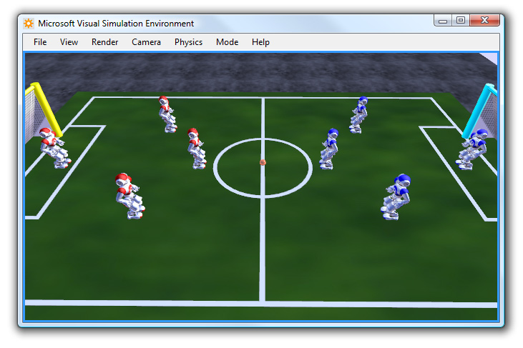
RoboCup
RoboCup Rescue
RoboCup Soccer

Slide 17
MRDS 2008 Licensing
Academic Edition | Researchers and Students. Free unlimited runtime distribution. Via Academic Portal.
Standard Edition | Professional Developers. Free unlimited runtime distribution $499
Express Edition | Hobbyists. Not permitted to distribute runtime $Free
More information at http://microsoft.com/robotics

Slide 18
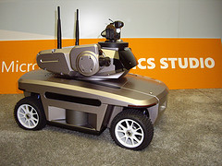
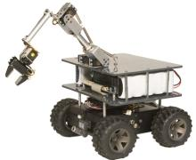
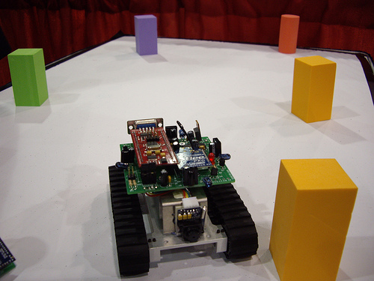
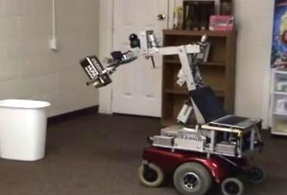
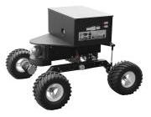
"Students really appreciate the Visual Simulation Environment that enables them to go home, work on their algorithms, create different prototypes, and then run them on the robot in the lab the next morning."
"Using CCR and DSS our developers created a complex robotics application in just two months. Using our old development tools that project would have required at least one year."

Slide 19
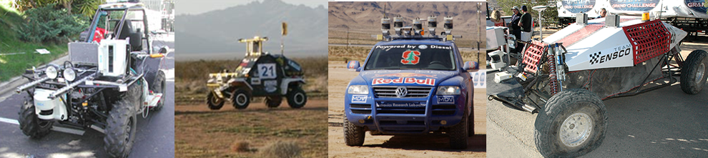
The Future?
“A driverless car is an autonomous vehicle that can drive itself from one point to another without assistance from a driver.”
DARPA Grand Challenge
RoboChamps Urban Challenge

Slide 20
Summary
Simpler concurrency and distributed computing
Reusable components and standardization
Lower barrier to entry
All of these advantages are now available for mobile, embedded, desktop and server platforms.
Notes:
SESSION SUMMARY. PROVIDE A SUMMARY FOR YOUR SESSION. REVIEW COVERED TOPICS WITH AUDIENCE.

Slide 21
Additional Resources
Technical Resources
Microsoft Robotics http://www.microsoft.com/robotics/
Microsoft Robotics Developer Centre http://msdn.microsoft.com/en-us/robotics/default.aspx
Coding4Fun: Microsoft Robotics Studio and Lego Mindstorms NXT http://blogs.msdn.com/coding4fun/archive/2007/07/16/3902344.aspx
CCR at MySpace http://channel9.msdn.com/shows/Communicating/CCR-at-MySpace/
Training Resources
Learn http://www.microsoft.com/robotics/#Learn
Community Resources
Microsoft Robotics Blog http://blogs.msdn.com/MSRoboticsStudio/

Slide 22

© 2008 Microsoft Corporation. All rights reserved. Microsoft, Windows, Windows Vista and other product names are or may be registered trademarks and/or trademarks in the U.S. and/or other countries.
The information herein is for informational purposes only and represents the current view of Microsoft Corporation as of the date of this presentation. Because Microsoft must respond to changing market conditions, it should not be interpreted to be a commitment on the part of Microsoft, and Microsoft cannot guarantee the accuracy of any information provided after the date of this presentation. MICROSOFT MAKES NO WARRANTIES, EXPRESS, IMPLIED OR STATUTORY, AS TO THE INFORMATION IN THIS PRESENTATION.

